Slide 1
Chapter 7: Visual Rendering
Beck Peterson

Slide 2
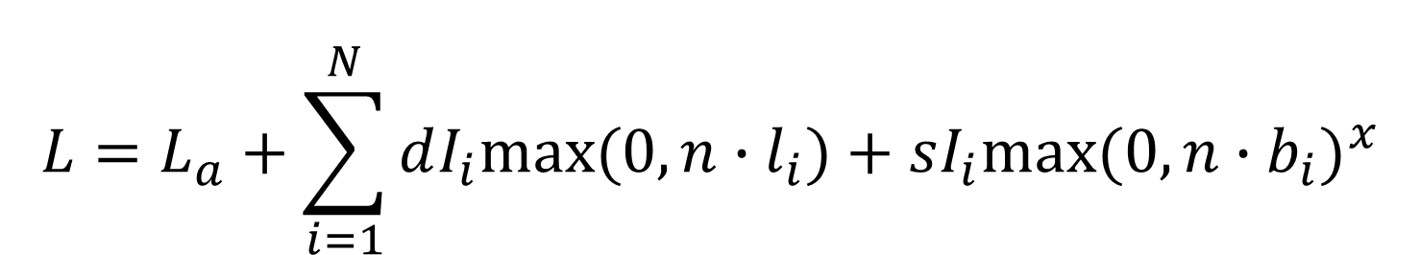

$$L=L_{a}+\sum_{i=1}^{N}{dI_{i}\text{max}(0, n∙l_{i})}+{sI_{i}\text{max}(0,n∙b_{i})}^{x}$$
Calculation for ray casting
$L$ is an rgb vector

Slide 3
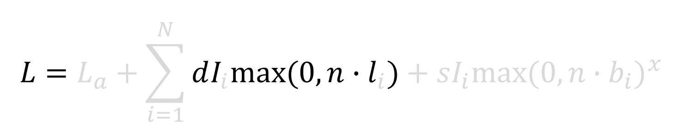

$$L=L_{a}+\sum_{i=1}^{N}{dI_{i}\text{max}(0, n∙l_{i})}+{sI_{i}\text{max}(0,n∙b_{i})}^{x}$$
$n$ is the surface normal
$l$ is the vector facing the light source
$n∙l=\cos{θ}$
$d$ is level or reflectiveness
$I$ is the color of the light

Slide 4
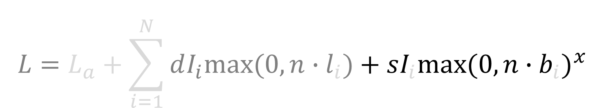

$$L=L_{a}+\sum_{i=1}^{N}{dI_{i}\text{max}(0, n∙l_{i})}+{sI_{i}\text{max}(0,n∙b_{i})}^{x}$$
$b$ is the bisector between $l$ and the reflected vector
$x$ determines surface shininess
$x=100$ would be mild shininess
$x=10,000$ would be mirror-like

Slide 5
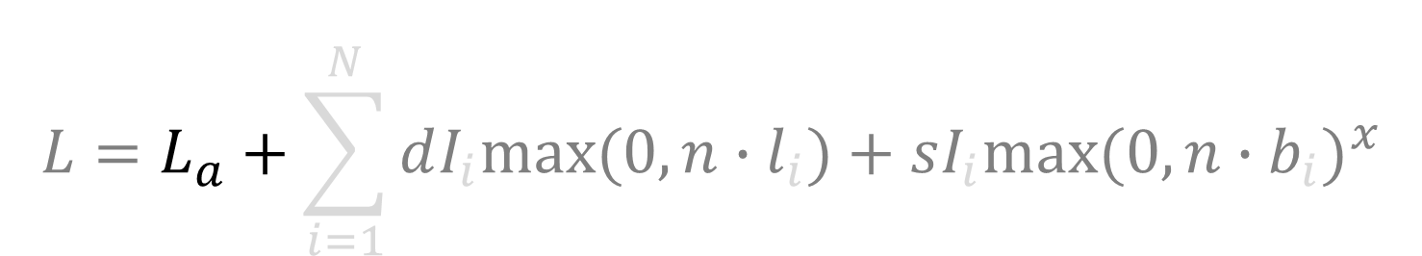

$$L=L_{a}+\sum_{i=1}^{N}{dI_{i}\text{max}(0, n∙l_{i})}+{sI_{i}\text{max}(0,n∙b_{i})}^{x}$$
$L_{a}$ is the ambient lighting

Slide 6
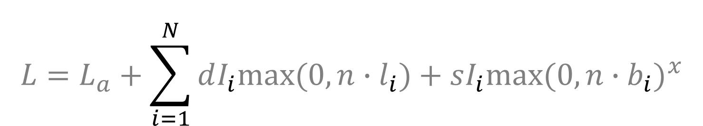

$$L=L_{a}+\sum_{i=1}^{N}{dI_{i}\text{max}(0, n∙l_{i})}+{sI_{i}\text{max}(0,n∙b_{i})}^{x}$$
$N$ is the number of light sources

Slide 7
$$L=L_{a}+\sum_{i=1}^{N}{dI_{i}\text{max}(0, n∙l_{i})}+{sI_{i}\text{max}(0,n∙b_{i})}^{x}$$
Approximation struggles in VR

Slide 8
Rasterization
The process of turning shapes into triangles
The process of turning triangles into pixels
Object-order rendering
Depth cycles (overlapping triangles)
Fixed by depth buffer or z-buffer

Slide 9
Barycentric coordinates
Weighted position based on triangle vertices
Used for z-buffer and mapping images
Also used for normal and bump mapping

Slide 10
Anti-Aliasing and Culling
To counteract pixelization of rasterization
Spatial aliasing uses mipmaps
Culling removes triangles to render
Backface culling removes triangles that face away
Occlusion culling removes obstructed triangles

Slide 11
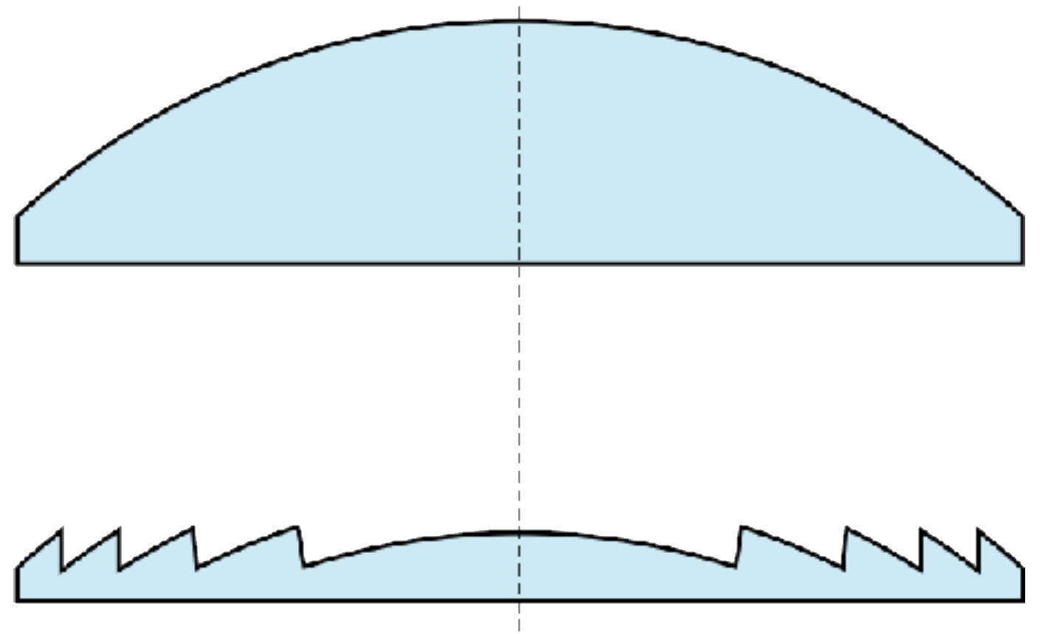
VR Distortions
Fresnel lens ‘frenelle’
Image rendered with barrel distortion
Peripheral pixels become distorted

Slide 12
Latency
High motion-to-photon latency can break illusion
A fast head turn can cause 10s of pixels of error
0 latency would be theoretically perfect
Perfect latency is impossible

Slide 13
Reduce Latency
Lower world complexity
Improve rendering pipeline and double buffer
Use prediction
Distort rendered image to compensate
Increase framerate

Slide 14
Immersive Photos
Mapping onto a screen
Using 3d camera
Map onto sphere
Panoramic light fields

Slide 15
Thank You
Beck Peterson

